Slide 1


Popular Content
Category
Social Buzz

Slide 2


Today's agenda
Project recap
Problem
The Analytics team
Process
Insights
Summary

Slide 3


The aim of the project was to come up with the top 5 most popular category of content
It involved:
Understanding the data
Preprocessing
Cleaning
Merging
Data Modeling
Analysis
Project Recap

Slide 4

Problem
Social Buzz has over 100,000 post
With over 35,000,000 pieces of content to be analyzed for insight
How can this data provide insight
to the company?
Analyzing Social Buzz’s top 5 most
popular content category

Slide 5




Andrew Fleming
Chief Technical Architect
The
Analytics
team
Marcus Rompton
Senior Principle
Problem
Olunga Odhiambo
Data Analyst

Slide 6

Understanding the data
Process
1
Cleaning the data
2
Modeling the data
3
Data Analysis
4
5
Get the Insight

Slide 7


Insights
16
74672
January
Unique Categories
Reactions to Most Popular Category (Animal) by Aggregate Score
Month with the most popular post

Slide 8
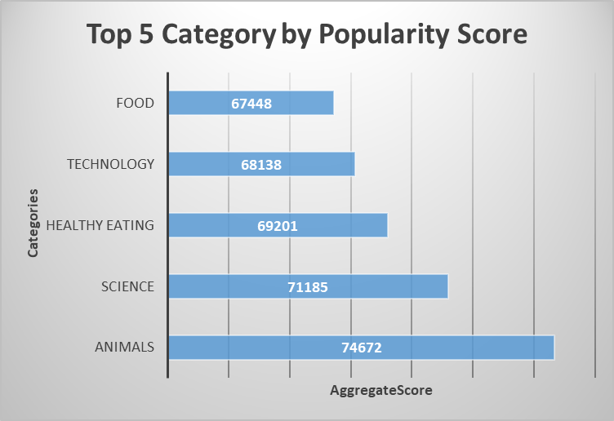

Slide 9
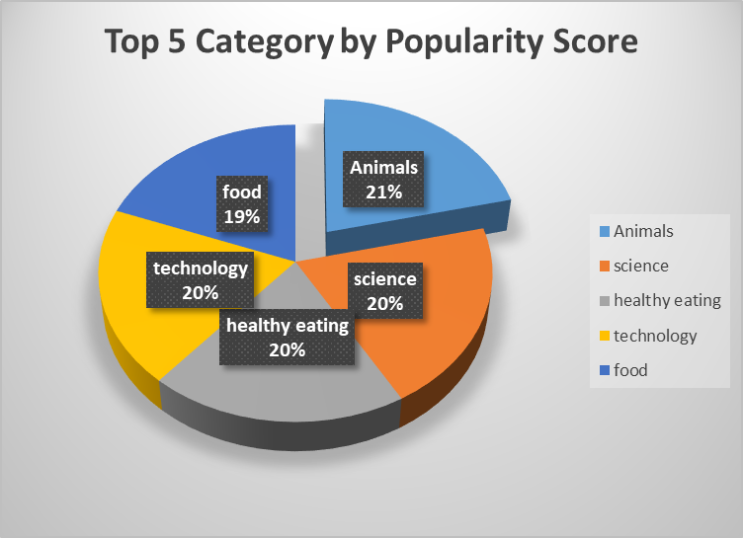

Slide 10


Analysis:
The most popular content categories are animals and science, indicating a preference for life in nature and factual content.
Insight:
Food (Healthy Eating), is a strong theme among the top 5 categories, suggesting an opportunity to target health-conscious users. Consider partnering with healthy eating brands to enhance engagement.
Next Steps:
While this analysis is useful, it's time to scale it for real-time insights. We can guide you through this process.
Summary

Slide 11


Thank you!
ANY QUESTIONS?

